Slide 1

Classification Of Documents
Using NLP
<Team 6>
Danniel Joshua
Geerath Bhatt
Rushikesh Gore
Rakhi Renjith
Suraj Tekkekar
Kedar Chougule

Slide 2
CONTENTS
Problem Statement
Project Architecture/Flow
EDA
Data Visualization
Model Building
Model Deployment

Slide 3
Project Architecture / Project Flow
Feature Engineering
Data Preparation
Data Cleaning
EDA
Imputation
Handling Outliers
Encoding
Scaling
Handling Imbalance
Model Building
1. Train/Test Split
2.Train variety of classification models
Feature
Selection
Dataset
Model Evaluation
1. Evaluate model using evaluation metrics.
2. Select best model.
Model Deployment

Slide 4
Exploratory Data Analysis (EDA)

Slide 5
Data Set Category
The data set includes the following variables:
• account_length
• voice_mail_plan
• voice_mail_messages
• day_mins
• evening_mins
• night_mins
• international_mins
• customer_service_calls
• international_plan
• day_calls
• day_charge
• evening_calls
• evening_charge
• night_calls
• night_charge
• international_calls
• international_charge
• total_charge
• churn: This is the target variable.
It is the one that determines whether the client is still in the company or not. (1-Churn, 0-No Churn)

Slide 6
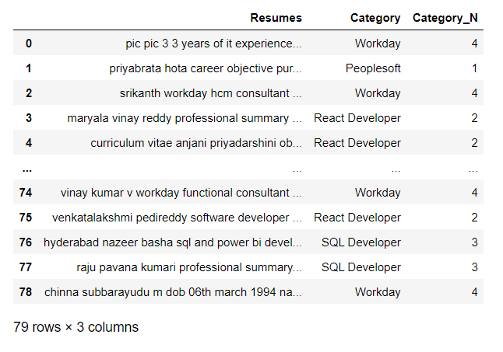
Import Libraries and Dataset

Slide 7
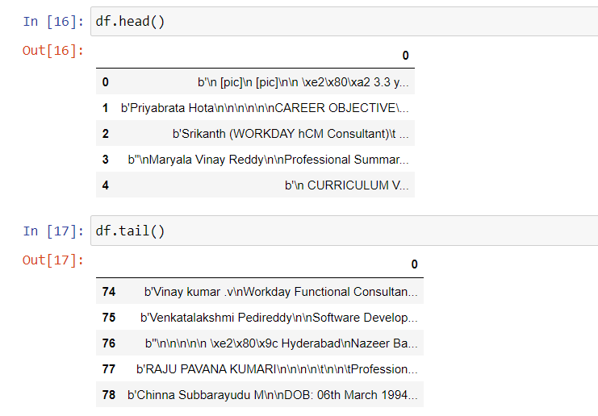
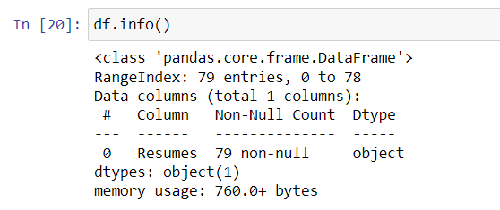
Exploratory Data Analysis (EDA)

Slide 8
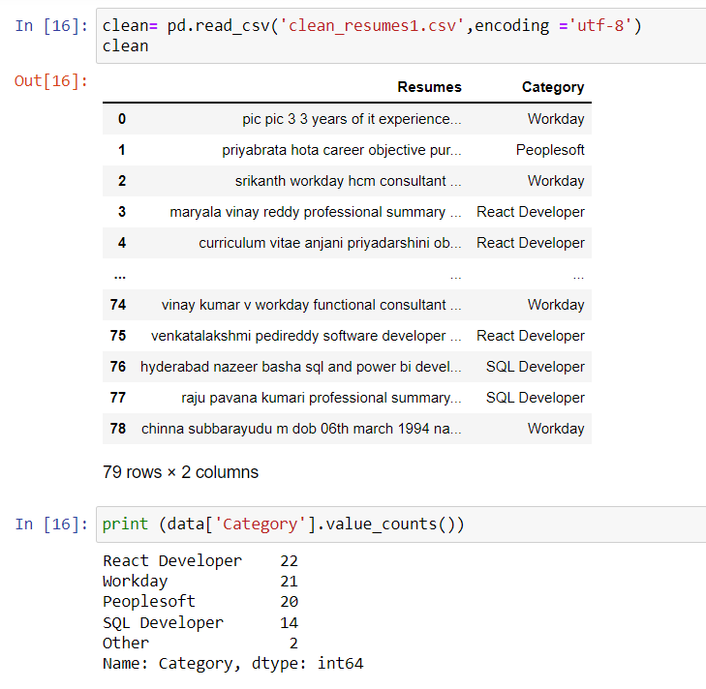
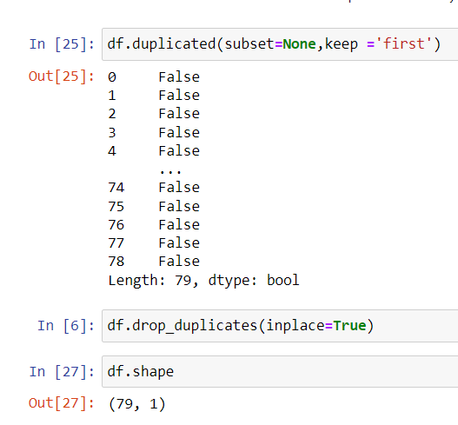
Data cleaning

Slide 9
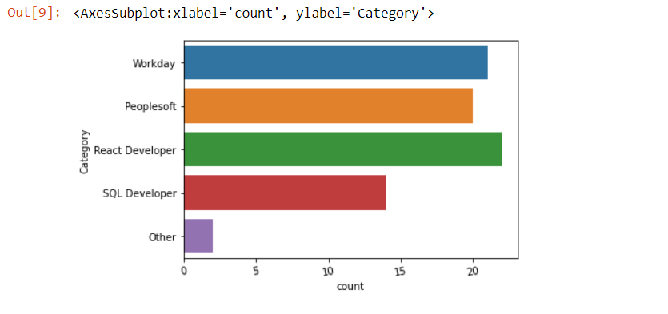
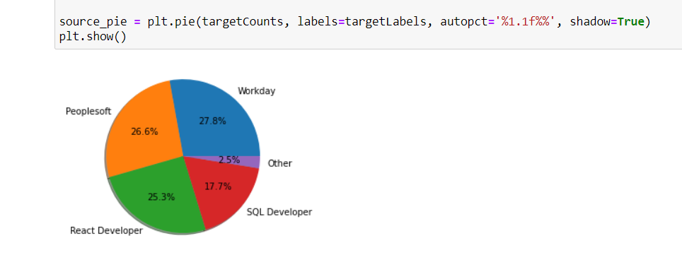
Data Visualization
Count Plot and Piechart

Slide 10
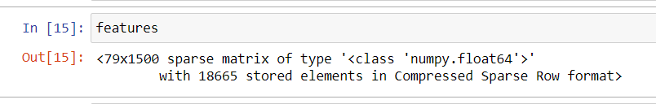
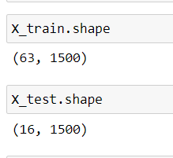
Feature Scaling
Standardization - Using Standard Scaler
Train/Test Data Splitting

Slide 11
Model Building

Slide 12
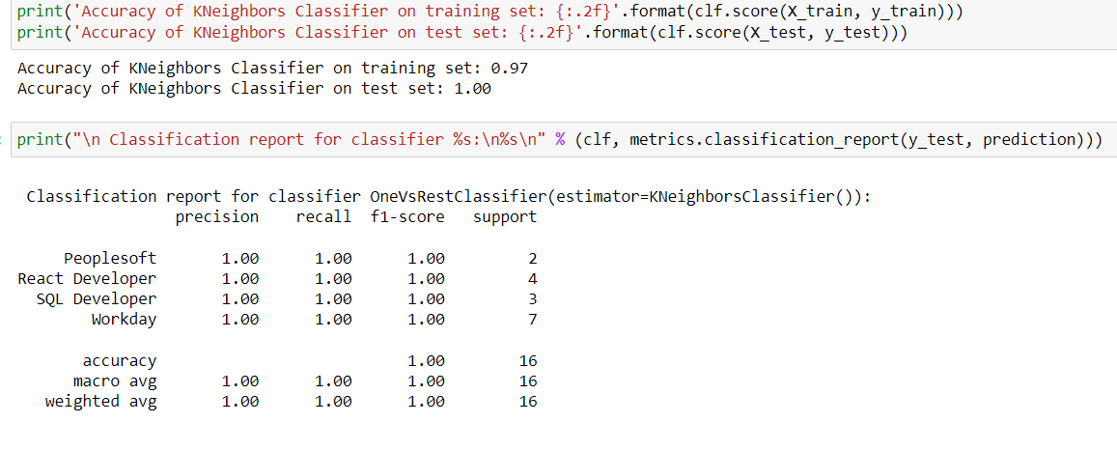
KNeighbors Classifier

Slide 13
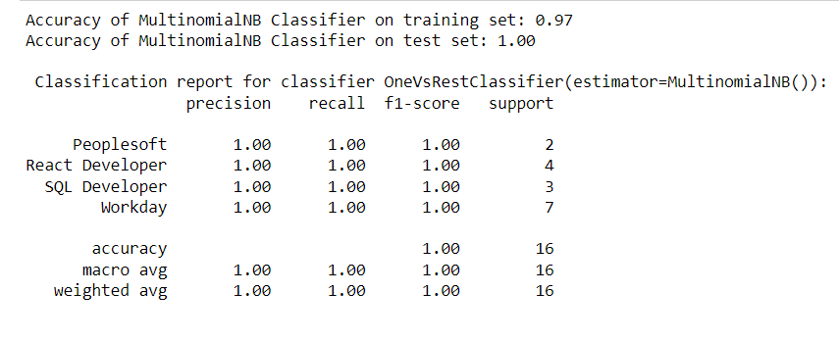
MultinomialNB Classifier

Slide 14
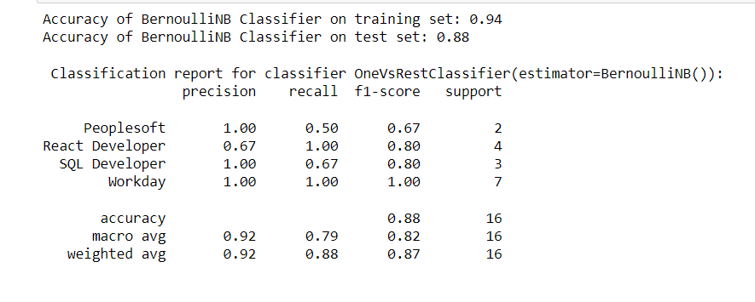
BernoulliNB Classifier
.

Slide 15
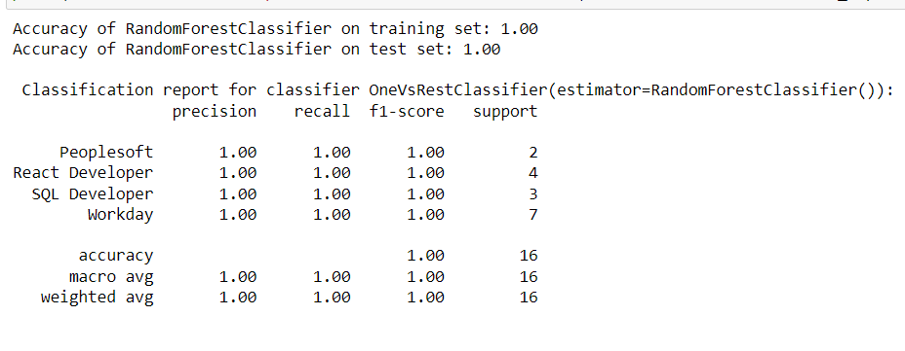
RandomForest Classifier

Slide 16
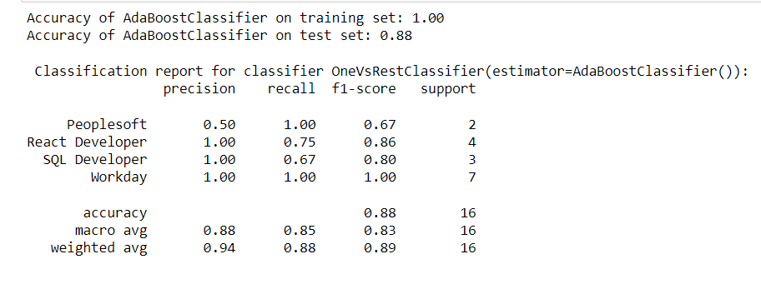
AdaBoost Classifier

Slide 17
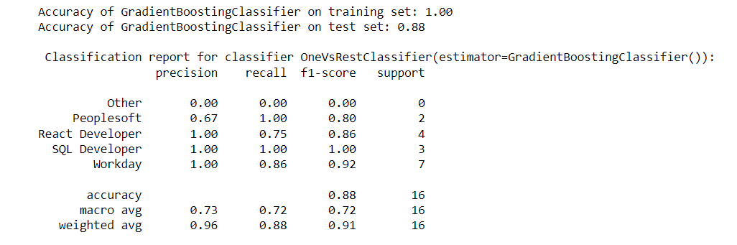
GradientBoosting Classifier

Slide 18
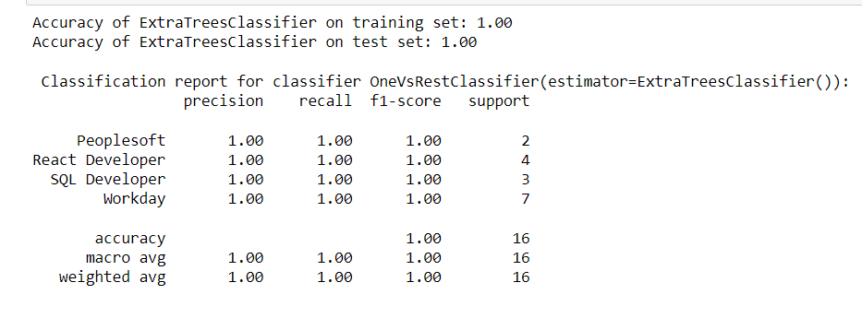
ExtraTree Classifier

Slide 19
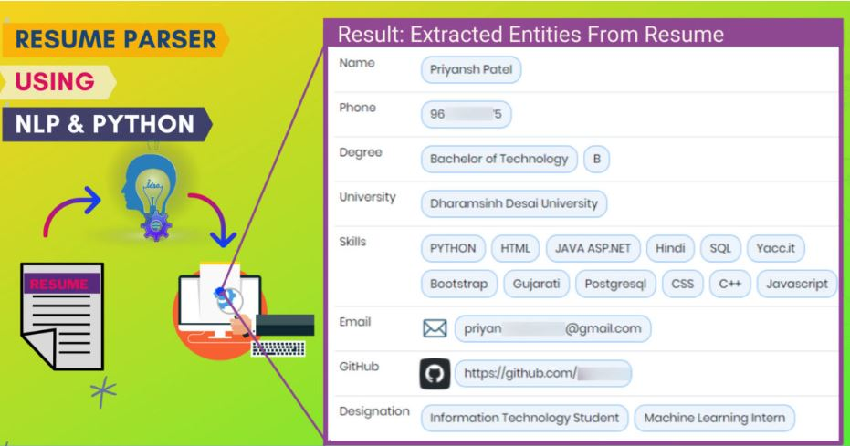
MODEL DEPLOYMENT
Model Deployment using streamlit

Slide 20
Challenges
Pdf to text conversion
Docx to text conversion
Address parsing
Manual Tagging
Nationality tagging
How did you overcome?
Pdf to text conversion
We have tried various open source python libraries like pdf_layout_scanner, pdfplumber, python-pdfbox, pdftotext, PyPDF2, pdfminer.six, pdftotext-layout, pdfminer.pdfparser pdfminer.pdfdocument, pdfminer.pdfpage, pdfminer.converter, pdfminer.pdfinterp. Each one has their own pros and cons. One more challenge we have faced is to convert column-wise resume pdf to text.After trying a lot of approaches we had concluded that python-pdfbox will work best for all types of pdf resumes.

Slide 21
Docx to text conversion
First we were using the python-docx library but later we found out that the table data were missing.After that our second approach was to use google drive api, and results of google drive api seems good to us but the problem is we have to depend on google resources and the other problem is token expiration.Somehow we found a way to recreate our old python-docx technique by adding table retrieving code. And it is giving excellent output. Here note that, sometimes emails were also not being fetched and we had to fix that too.
Address parsing
It is very difficult, especially Indian addresses. Some of the resumes have only location and some of them have full address.We have tried various python libraries for fetching address information such as geopy, address-parser, address, pyresparser, pyap, geograpy3 , address-net, geocoder, pypostal.Finally, we have used a combination of static code and pypostal library to make it work, due to its higher accuracy.

Slide 22
Manual Tagging
Manual label tagging is way more time consuming than we think. Since we not only have to look at all the tagged data using libraries but also have to make sure that whether they are accurate or not, if it is wrongly tagged then remove the tagging, add the tags that were left by script, etc.We have used Doccano tool which is an efficient way to create a dataset where manual tagging is required. We highly recommend using Doccano.
Nationality tagging
Nationality tagging can be tricky as it can be language as well. For example, Chinese is nationality too and language as well. So, we had to be careful while tagging nationality
Limitations in creating Dataset
It can not parse informations like:
Year of graduation
Achievements
Strength and weaknesse
Objective / Career Objective: If the objective text is exactly below the title objective then the resume parser will return the output otherwise it will leave it as blank
CGPA/GPA/Percentage/Result: By using regular expression we can extract candidate’s results but at some level not 100% accurate
Date of birth:
As the resume has many dates mentioned in it, we can not distinguish easily which date is DOB and which are not.
We can try an approach, where, if we can derive the lowest year date then we may make it work but the biggest hurdle comes in the case, if the user has not mentioned DoB in the resume, then we may get the wrong output.
esume, then we may get the wrong output.

Slide 23
Flaws in result of NLP Model
Fetching the address
Even after tagging the address properly in the dataset we were not able to get a proper address in the output.
One of the major reasons to consider here is that, among the resumes we used to create a dataset, merel 10% resumes had addresses in it.
Future roadmap
Improve the accuracy of the model to extract all the data.
Test the model further and make it work on resumes from all over the world.
Make the resume parser multi-lingual
Improve the dataset to extract more entity types like Address, Date of birth, Companies worked for, Working Duration, Graduation Year, Achievements, Strength and weaknesses, Nationality, Career Objective, CGPA/GPA/Percentage/Result.
Make Resume Parser available via API

Slide 24
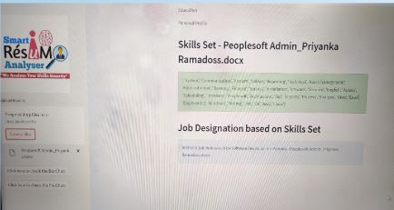
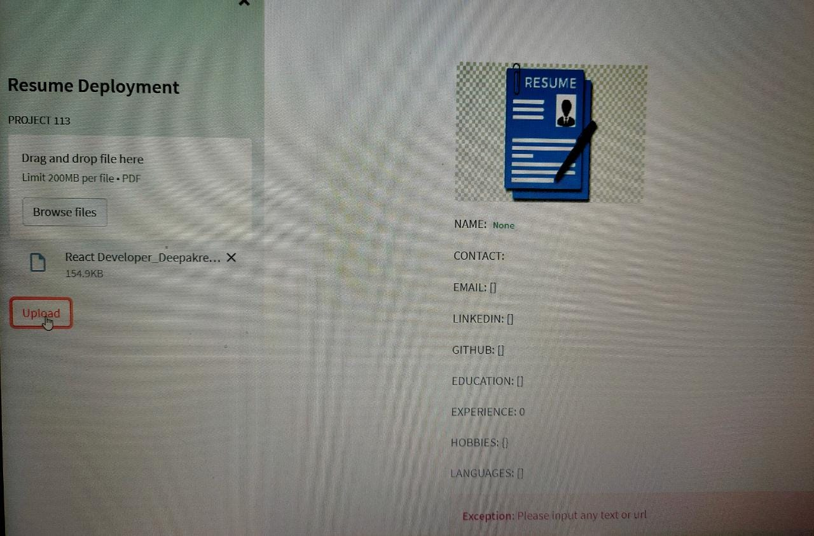

Slide 25
THANK YOU

